Slide 1
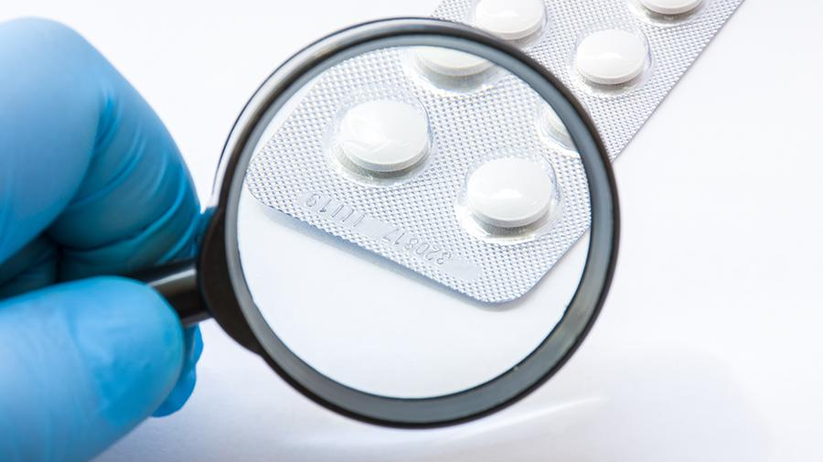
Drug Authentication Using Blockchain
Blockchain the trust solution for the healthcare industry

Slide 2

Abdulrhman El Sayed Saeed [ Information Systems]
Kareema Magdy Awad [Information Systems]
MennaT'allah Abdel_fattah Mohammed [Information Systems]
Ramy Makram Eyd [Information Systems]
Reham Raafat Shokry [Information Systems]
Under Supervision of
Dr. Tamer Mostafa
Information Systems Department
Faculty of Computer & Information Sciences
Ain Shams University
TA. Eman Bahgat
Information Systems Department
Faculty of Computer & Information Sciences
Ain Shams University

Slide 3

Agenda
Introduction
Motivation & Problem definition
Objectives
Observation
Blockchain
System Architecture
Analysis and design diagrams
Functional Requirement
Techniques & Ethereum
Results
Demo
Tools
Conclusion
Future Work
References

Slide 4

Introduction
Health is a crown to the heads of healthy people, and it is one of the most important blessings that God has given us, so we must preserve it well so that we can complete our missions and messages in the life for which we were created. But unfortunately, the drug counterfeit problem has become global and so huge that it has drawn significant attention from everyone.
The fake drug industry is worth $10B per year as estimated by survey. Also estimated by WHO, about a million die per year due to fake drugs. The distribution of fake drugs is a crucial issue.
One of main reasons behind drug counterfeiting is imperfect supply chain.

Slide 5
Motivation
Drug manufacturing is expensive, and it takes approximately two billion dollars to manufacture a single type of drug. Replacement of these drugs with counterfeit
drugs is a prevailing problem and causes about 150 billion-dollar, loss to the pharmaceutical industry annually.
In addition to loss of money, counterfeit drugs also pose a threat to lives, and sabotages reputed brand names.
The counterfeit drug problem is encouraged because of lack of coordination and traceability of the drug itself within the pharmaceutical supply chain

Slide 6

Problem Definition
How to make all medicine data secure and prevent anyone from changing it.
Deliver original medicine from manufactures to countries
How to make all people check the medicine after buying it.
We start thinking about the technology that would help us To solve these Problems
Notes:
Three major negative implications of drug counterfeiting.
Drug counterfeiting is a major business problem for pharmaceutical companies around the globe.
Drug counterfeiting is a major problem for the society, government and pharmaceutical brand owners.
Around the globe, drug counterfeiting is not a huge problem for developed countries, as they have limited distributors with deep market presence and there has been a consolidation of distributors over the years.
In contrast, developing countries have many distributors, even at the city level, which results in a fragmented market.

Slide 7

Objectives
Reduced health risks
Decreased costs
Faster orders
Increased transparency
Secured Medicine Data
Notes:
Reduced health risks
The blockchain brings together a network of certified parties. That means that drugs are sourced from legitimate pharmaceutical companies that manufacture drugs according to industry standards. As a result, patients stay safe because the drugs they consume are also safe.
Decreased costs
Counterfeit drugs increase costs because they lack the active ingredient needed to cure diseases. However, authentic drugs work as they should hence curing patients within the expected time period.
Faster orders
The blockchain makes the process of finding trustworthy pharmaceuticals easy and fast. Additionally, a pharmaceutical company can view on the blockchain which carriers are available to make deliveries immediately.
Increased transparency
At each stage of the supply chain, parties authenticate using the blockchain and the drugs are verified through QR codes and serial numbers. In addition, every transaction is recorded on the blockchain and it can be traced and tracked. Therefore, the possibility of getting a different package from what was registered on the blockchain by the pharmaceutical is effectively non-existent.
The war against counterfeit drugs in Developing Countries might seem difficult but with the implementation of the blockchain in the pharmaceutical supply chain, it can be won. In a sector where it is difficult to know who you can trust and who you cannot, the blockchain creates trust.

Slide 8
Observation
NAIROBI
A cell phone application for identifying approved medicines and drugstores is helping Kenya to fight counterfeit and substandard medicines. The app uses a barcode and location tracking technology to identify medicines throughout the supply chain
FD Detector
a group of local teenage girls from Nigeria decided to act and create a mobile application that detects fake drugs at the point of purchase. The app allows health professionals and customers with a smartphone to scan the barcode in a drug. The app then indicates whether the drug is authentic or fake and displays the drug’s expiry date. The innovation also has a provision for users to report any fake drugs directly to the regulator.

Slide 9
The solution is Blockchain

Slide 10
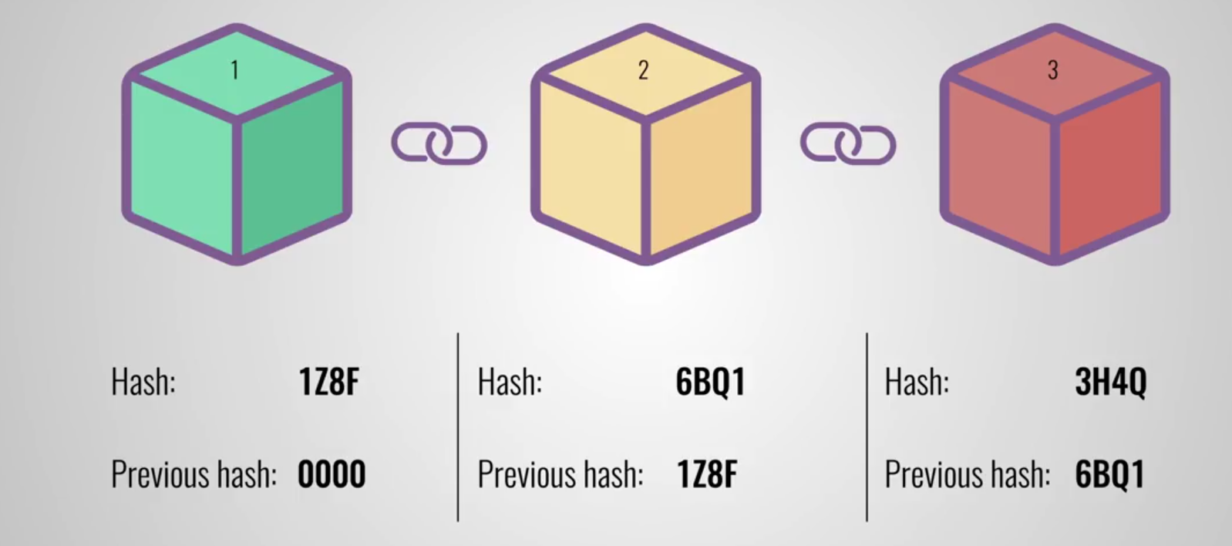
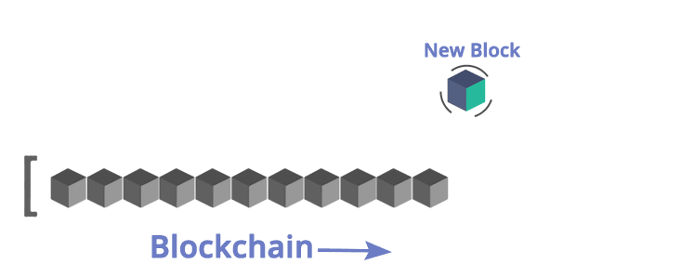
Introduction to Blockchain
Blockchain technology is a structure that stores transactional records, also known as the block, of the public in several databases, known as the “chain,” in a network connected through peer-to-peer nodes.
Typically, this storage is referred to as a ‘digital ledger.’ Every transaction in this ledger is authorized by the digital signature of the owner, which authenticates the transaction and safeguards it from tampering.
Hence, the information the digital ledger contains is highly secure.

Slide 11
Blockchain Features
Immutability
Decentralized
Enhanced Security
Distributed Ledgers
Consensus
Faster Settlement

Slide 12
Let’s Focus on medical Sector

Slide 13
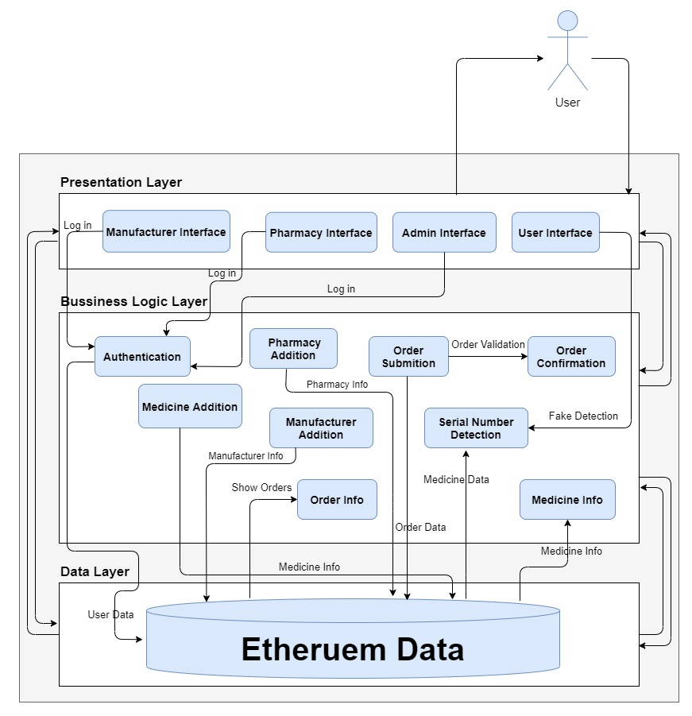
System Architecture

Slide 14
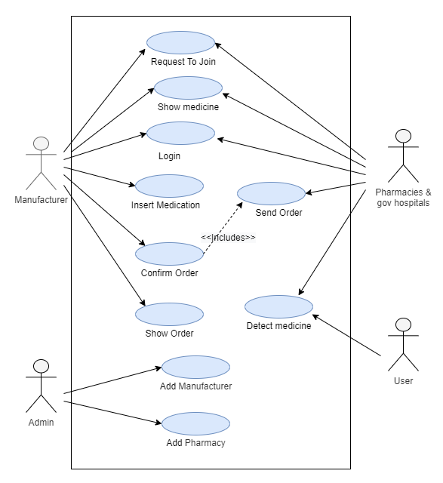
Use Case Diagram
Notes:
Conventional is traditional system: this system, all the handovers are recorded on papers, and each partaker must trust others in the network. Tracing back the source point of counterfeit medicine or any other discrepancy is very difficult.
Vledder et al : solves the problem of drug traceability and supply-chain inside a hospital by using IoT and web-services technologies; nevertheless, this system is bound to work in a limited geographical area and doesn’t offer an utterly trustless computing environment
Mouaky et al : he major drawback of this system lies in that it offers a single point of failure. If the centralized server is compromised, the integrity of the whole network becomes questionable.

Slide 15
Functional Requirements
Manufacturer:
Request to join
Login/Logout
Insert Medication
Show order and medicine
Confirm Order
Notes:
Manufacturer:
Request to join:
Description:
This function allows unregistered Manufacturer to enroll and to create a new account with the website, in order to create a new account, the Manufacturer has to provide required information to admin Such as username, and password.
Input:
username and password.
Source:
Manufacturer.
Pre-conditions:
The manufacturer must not have an existing account with the website.
Post-conditions:
A manufacturer account is created.
Output: None.
Login/Logout:
Description:
This function allows a registered Manufacturer to login this account
and log out after the work is done.
Input:
The manufacturer of the website logs into the application with the
username and password provided him.
Source:
Manufacturer.
Pre-conditions:
manufacturer is not logged in to system. Manufacturer has
previously
enrolled in the system.
Post-conditions:
Manufacturer is logged in to system, OR Manufacturer is not logged
in because he/she entered unrecognized information.
Output:
The website displays the homepage of the Manufacturer.
Insert Medication:
Description:
This function allows the Manufacturer to add medicine information in the data Ethereum.
Input:
The Medicine information (Name, Serial Number,
Production Date, Expire Date).
Source:
Manufacturer.
Pre-conditions:
The manufacturer must have an account with the website.
Post-conditions:
Medicine information has added in the data Ethereum by manufacturer.
Output:
None.
Confirm order:
Description:
This function allows the Manufacturer to accept or reject the order that is sent from pharmacy.
Input:
None.
Source:
Manufacturer.
Pre-conditions:
The manufacturer must have an account with the website.
Post-conditions:
Order has accepted or rejected.
Output:
None.
Show order and medicine:
Description:
This function allows the Manufacturer to view the medicine information that has added from manufacturer or order that has sent from pharmacy.
Input:
None
Source:
System
Pre-conditions:
The manufacturer must have an account with the website.
Post-conditions:
None.
Output:
Show all information about available medicine or order.

Slide 16
Functional Requirements
Pharmacies & gov hospitals
Request to join
Login/Logout
Send Order
Show medicine
Detect medicine
Notes:
Pharmacy:
Request to join:
Description:
This function allows unregistered pharmacy to enroll and to create a new account with the website, in order to create a new account, the pharmacy has to provide required information to admin Such as username, and password.
Input:
username and password.
Source:
Pharmacy
Pre-conditions:
The Pharmacy must not have an existing account with the website.
Post-conditions:
A Pharmacy account is created.
Output:
None.
Login/Logout:
Description:
This function allows a registered Pharmacy to login this account and
logout after the work is done.
Input:
The Pharmacy of the website logs into the
application with the username and password provided to
him.
Source:
Pharmacy.
Pre-conditions:
Pharmacy is not logged in to
system. Pharmacy has previously enrolled in the
system.
Post-conditions:
Pharmacy is logged in to system, OR
Pharmacy is not logged in because he/she entered.
unrecognized information.
Output:
The website displays the homepage of the
Pharmacy.
Show medicine:
Description:
This function allows the pharmacy to view the medicine information that has added from manufacturer.
Input:
None
Source:
System
Pre-conditions:
The pharmacy must have an account with the website.
Post-conditions:
None.
Output:
Show all information about available medicine.
Send order:
Description:
This function allows the pharmacy to select available medicine and send order to manufacturer.
Input:
available medicine that is selected.
Source:
pharmacy.
Pre-conditions:
The pharmacy must have an account with the website.
Post-conditions:
the manufacturer has accepted or rejected the order from pharmacy.
Output:
None.
Detect Medicine:
Description:
This function allows the pharmacy to detect medicine, is it fake or real through enter the serial number for medicine.
Input:
serial number for medicine
Source:
pharmacy.
Pre-conditions:
None.
Post-conditions:
None.
Output:
Show the medicine information if the serial number is unique and the medicine is real or message "the medicine is fake " if the serial number is not unique.

Slide 17
Functional Requirements
User:
Detect medicine:
Notes:
User:
Detect Medicine:
Description:
This function allows the user to detect medicine, is it fake or real through enter the serial number for medicine.
Input:
Serial number for medicine
Source:
user.
Pre-conditions:
None.
Post-conditions:
None.
Output:
Show the medicine information if the serial number is unique and the medicine is real or message "the medicine is fake " if the serial number is not unique.

Slide 18

Techniques
Technology
Ethereum
HTML & CSS
React.js
Web3.js

Slide 19
Ethereum
Ethereum is an open blockchain platform that lets anyone build and use decentralized applications that run on blockchain technology.

Slide 20
Smart contracts
A contract in the sense of Solidity is a collection of code (its functions) and data (its state) that resides at a specific address on the Ethereum blockchain.

Slide 21
solidity
Solidity is a contract-oriented programming language for writing smart contracts.

Slide 22
web3.js
Ethereum JavaScript API. web3.js is a collection of libraries which allow you to interact with a local or remote ethereum node, using a HTTP or IPC connection.

Slide 23

Results

Slide 24
Accuracy
Train test
Then accuracy
Process time
Notes:
50 medicine
Train 70%
Test 30%
Time processing : depending on internet speed

Slide 25
Tools
IDE
VS code
Ganache

Slide 26
Future Work
Expand our system:
Expand our system to be use in all Egyptian ports and airports, also in pharmacies to detect fake medicine before entering the country.
Enhancing performance:
Adding distributors and transporter companies to systems
Developing website for medicines:
Developing website like amazon that contains all categories of medicine to make it easy for hospitals and pharmacies to order medicines.
Developing mobile apps:
Extending our system by building an android and iOS application and desktop application.
Reserve multi serial from same one medicine
Develop water mark.

Slide 27

Demo

Slide 28

Conclusion
Most of technology around us came from problems.
Our main problem is how to make checking on the medicines validity, became easier.
Blockchain technology is a structure that stores transactional records a blocks.
Ethereum is an open blockchain platform for making decentralized application.
Main function requirements: Register,Log in,Log out,insert medicine, view medicine, detect medicine, send order, confirm order.

Slide 29
References
Salman, T., M. Zolanvari, A. Erbad, R. Jain, and M. Samaka. 2018. Security services using blockchains: A state of the art survey. IEEE Communications Surveys and Tutorials 21 (1): 858–880.
Nakamoto, S. 2008. Bitcoin: A peer-to-peer electronic cash system.
Zheng, Z., S. Xie, H.-N. Dai, and H. Wang. 2016. Blockchain challenges and opportunities: A survey. International Journal of Web and Grid Services 1: 1–25.
Roehrs, A., C.A. da Costa, and R. da Rosa Righi. 2017. Omniphr: A distributed architecture model to integrate personal health records. Journal of Biomedical Informatics 71: 70–81.
Pharmaceutical industry in India. https://en.wikipedia.org/wiki/Pharmaceutical.
Mettler, M. 2016. Blockchain technology in healthcare: The revolution startshere. In 2016 IEEE 18th International conference on e-Health networking, applications and services (Healthcom), 1–3. IEEE.222 M. Sahoo et al.

Slide 30
References
Books
Anti-Counterfeit on Medicine Detection Using Blockchain Technology Authors: R. Anand, Khadheeja Niyas, Sorjeeta Gupta, S. Revathy Publisher: Springer Singapore
Courses
Ethereum and Solidity: The Complete Developer's Guide
Blockchain 2020 - Complete Blockchain Course for Beginners
Papers
Blockchain Technology in Pharmaceutical Industry to Prevent Counterfeit Drugs
Securing E-health Networks from Counterfeit Medicine Penetration Using Blockchain
Additional Links
https://ethereum.org/en/
https://ethereum.org/en/defi/
https://en.wikipedia.org/wiki/Ethereum
Smart Contract

Slide 31


Slide 32
Thanks

